Slide 1
Lecture 3
Linux Basic Commands
Linux Package Manager and Software installation

Slide 2
Topics of Lecture
Linux Basic Commands
Create Folder (mkdir)
Create File (touch)
List Folder/File (ls)
View File Contents (cat)
Text Editor (vi, nano)
Copy Folder/ File (cp)
Move File/ Folder (mv)
Delete File/ Folder (rm)
Help (man)
Package Installation (apt, apt-get, yum)
Advanced Packaging Tool
apt install [… packages]
apt remove [… packages] (removes packages from the system but not configuration files.)
apt purge [… packages] (removes both packages and configuration files form the system.)
apt update
apt upgrade

Slide 3
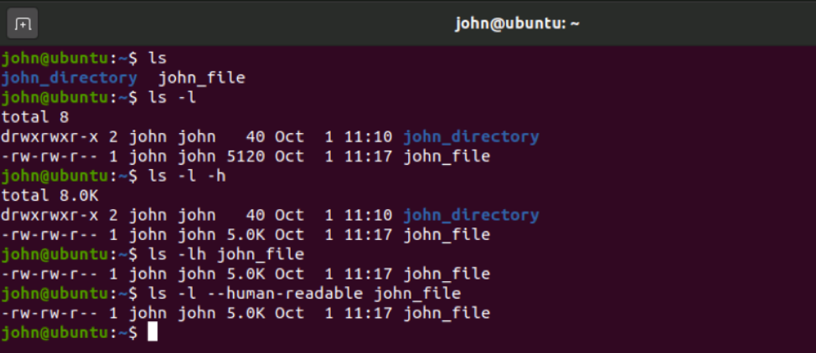
Command Line Interface
Terminal for your computer or EC2 machine.
Enable users to interact with the operating system.
Takes in commands and passes them on to the computer's operating system.
Output shows the reply from the operating system.

Slide 4
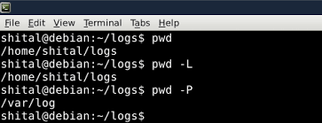
Linux Basic Commands
pwd: present working directory.

Slide 5
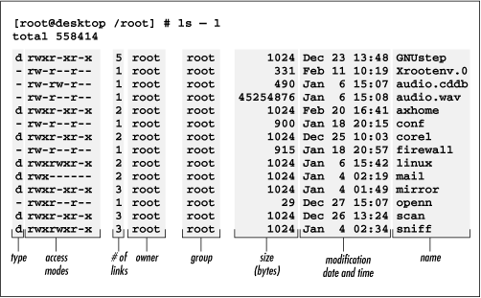
Linux Basic Commands
ls: list the files/ folders in a directory.

Slide 6
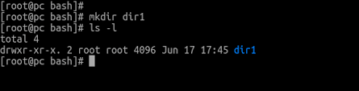
Linux Basic Commands
mkdir: make directory.

Slide 7
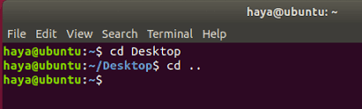
Linux Basic Commands
cd: to change directory, use 'cd' command

Slide 8
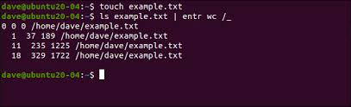
Linux Basic Commands
touch: commonly used for creating a new empty file.

Slide 9
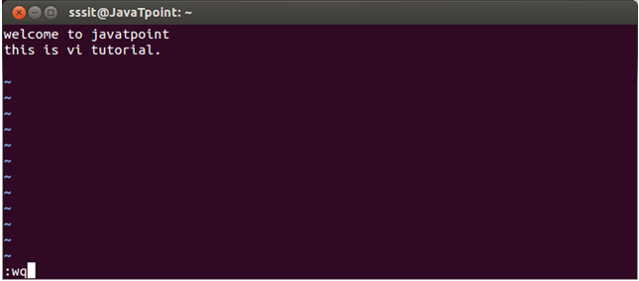
Linux Basic Commands
vi: screen-oriented text editor.

Slide 10
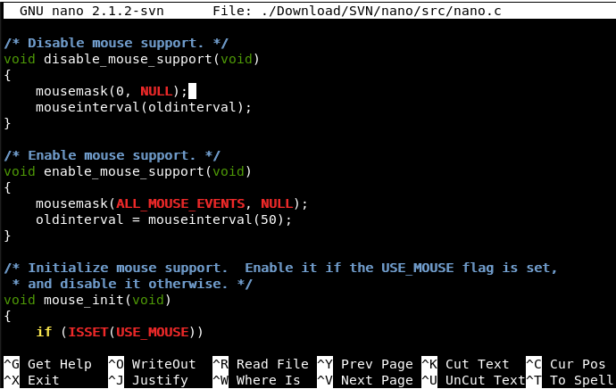
Linux Basic Commands
nano: text editor.

Slide 11
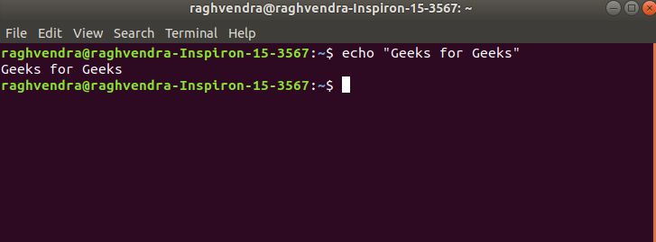
Linux Basic Commands
echo: display line of text/string.

Slide 12
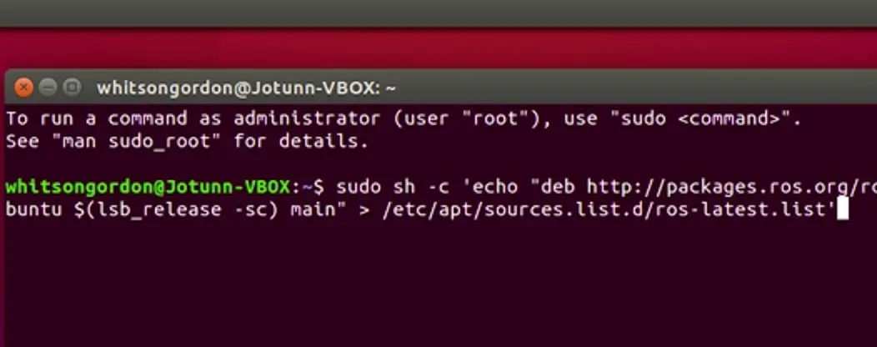
Linux Basic Commands
echo: write a line into a file using echo, write the command as
text > filename

Slide 13
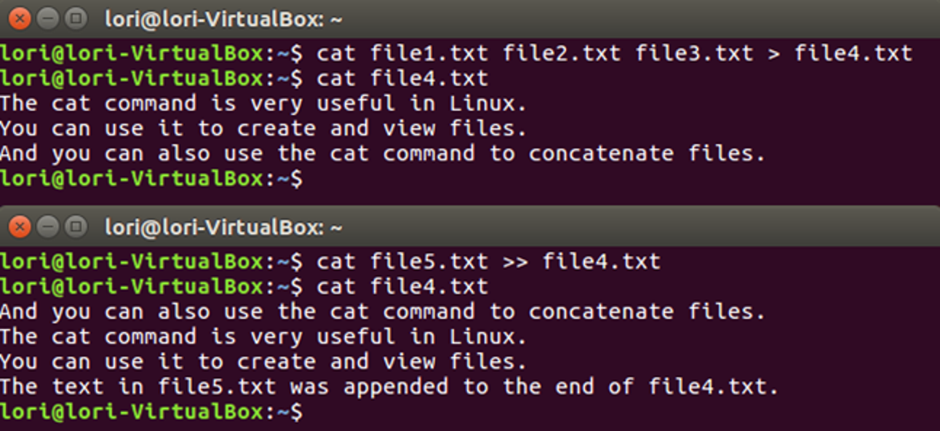
Linux Basic Commands
cat:
replace the content of a file with another file's content
(source > dest)
append the content of a file in another file
(source >> dest)

Slide 14
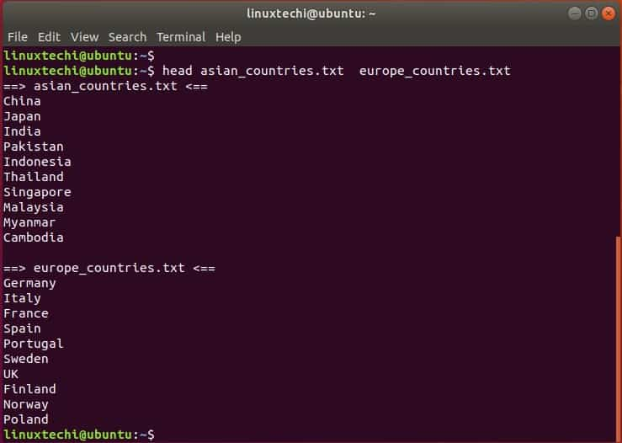
Linux Basic Commands
head: output start of a file.

Slide 15
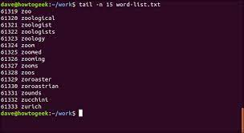
Linux Basic Commands
tail: output end of a file.

Slide 16
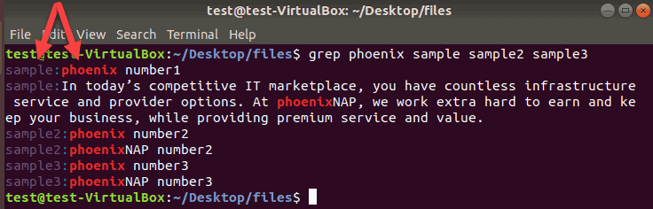
Linux Basic Commands
grep: search for a string of characters in a specified file.

Slide 17
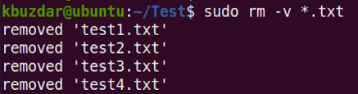
Linux Basic Commands
rm: removes each file specified.

Slide 18
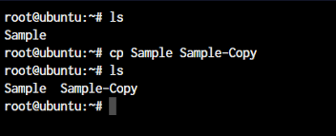
Linux Basic Commands
cp: copying files and directories to another location.

Slide 19
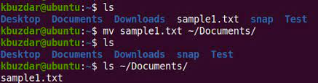
Linux Basic Commands
mv: move file or directory from one place to another.

Slide 20
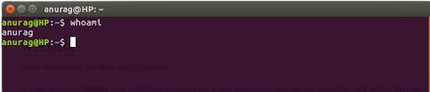
Linux Basic Commands
whoami: Print the current user name.

Slide 21
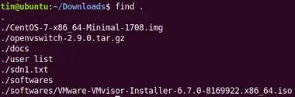
Linux Basic Commands
find: Search for files in a directory hierarchy

Slide 22
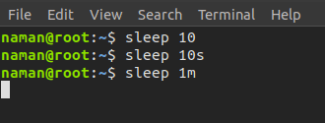
Linux Basic Commands
sleep : Delay for a specified amount of time

Slide 23
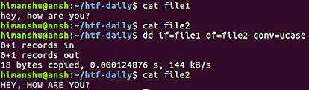
Linux Basic Commands
dd : Copy a file, converting and formatting.

Slide 24
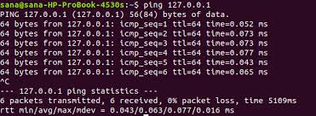
Linux Basic Commands
ping: Send ICMP ECHO_REQUEST to network hosts

Slide 25
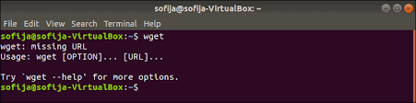
Linux Basic Commands
wget: Retrieve files via HTTP or FTP

Slide 26
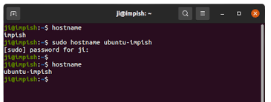
Linux Basic Commands
hostname: Get or set hostname or DNS domain name

Slide 27
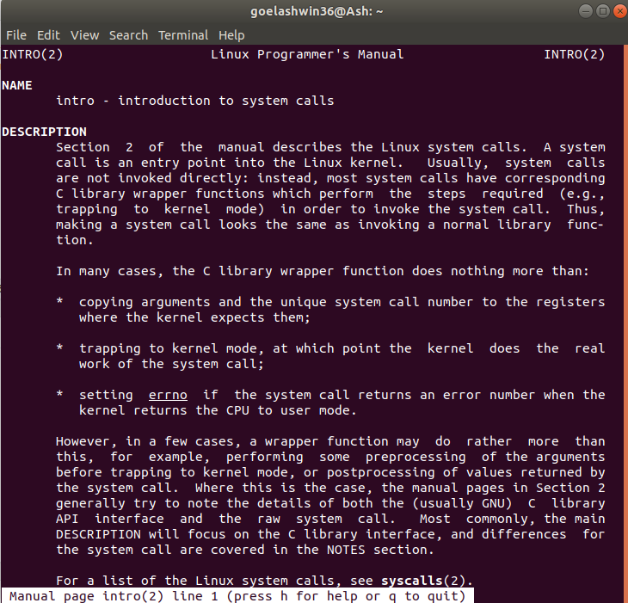
Linux Basic Commands
man: interface to the on-line reference manuals

Slide 28
Package Manager and Software Installation in Ubuntu

Slide 29
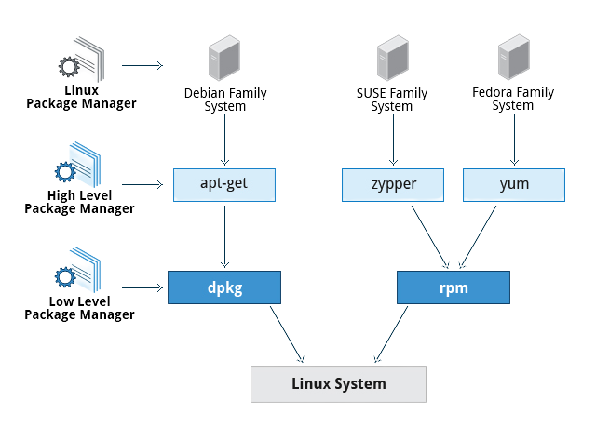
Package Manager
A collection of software tools that automates the process of installing, upgrading, configuring, and removing computer programs for a computer in a consistent manner.
A package manager deals with packages, distributions of software and data in archive files

Slide 30




Package Managers
apt: Advanced Package Tool (Ubuntu, Debian)
yum: Yellowdog Updater, Modified (CentOS)
rpm: Red Hat Package Manager (RehHat)
homebrew: package manager for MacOS

Slide 31
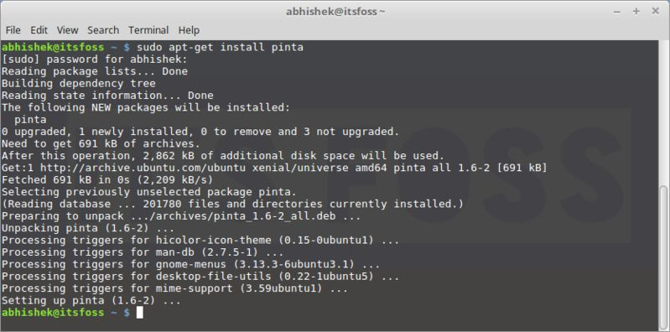
Package Manager
apt: Advanced package tool.

Slide 32
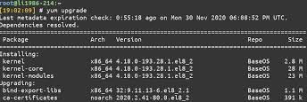
Package Manager
Yum: primary tool for getting, installing, deleting, querying, and otherwise managing Red Hat Enterprise Linux RPM software packages from official Red Hat software repositories.

Slide 33
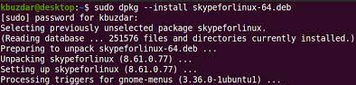
Package Manager
dpkg: Install, remove and manage Debian packages.

Slide 34
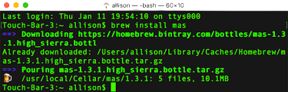
Package Manager
brew: free macOS package manager that allows you to install, update, or remove software by running commands in the terminal.

Slide 35
Advanced Package Tool
apt-get vs apt
apt-get
It has been around for a longer time and is considered the traditional command for managing packages.
It includes specific commands for various operations, such as apt-get install, apt-get remove, and apt-get update.
apt
apt is designed for end-users (humans) and its output may be changed between versions.

Slide 36
Repository
Collection of deb packages with metadata that is readable by the apt family
In Debian or Ubuntu, the software repositories are defined in /etc/apt/sources.list
Third-party repositories can be added in Ubuntu, add its link to the file mentioned above.

Slide 37
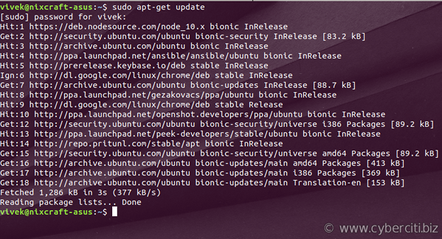
Software Update
apt update.
This command is used when we want to download package information from all configured sources.

Slide 38
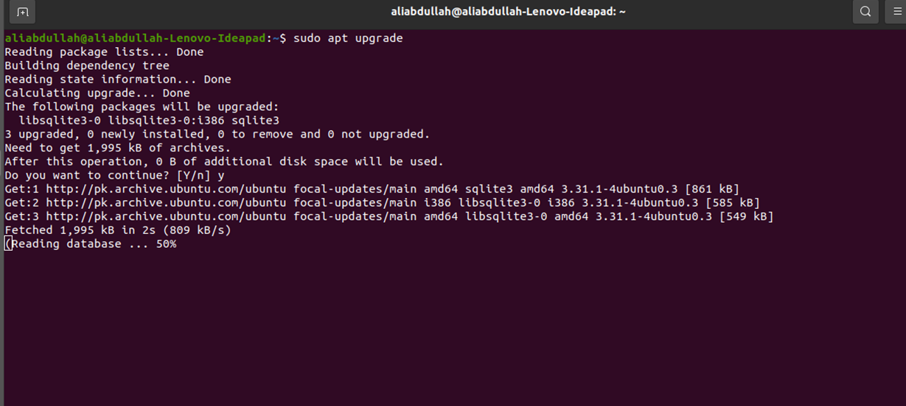
Software Upgrade
apt upgrade.
This command is used when we want to install available upgrades of all packages currently installed on the system from the sources configured via sources.list.
If new packages are required to satisfy dependencies, they will be installed, but already existing packages will never be removed.
If for a package to be upgraded, the removal of an installed package is required, the upgrade will not be performed.

Slide 39
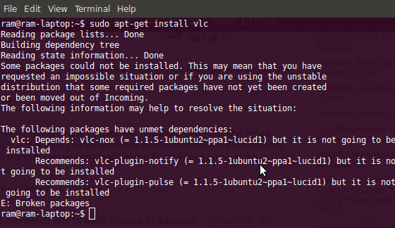
Software Install
apt install […package name]
apt install apache2

Slide 40
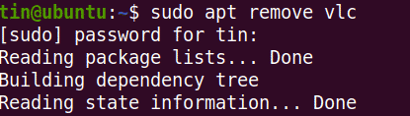
Software Deletion
apt remove […package-name]
apt remove apache2

Slide 41
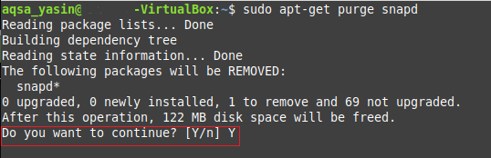
Software Deletion
(With all dependencies removed)
apt purge […package-name]
This command is similar to remove command, the only difference being that the purge command also removes any configuration files related to the removed packages.

Slide 42
Topics of Lecture
Linux Basic Commands
Create Folder (mkdir)
Create File (touch)
List Folder/File (ls)
View File Contents (cat)
Text Editor (vi, nano)
Copy Folder/ File (cp)
Move File/ Folder (mv)
Delete File/ Folder (rm)
Help (man)
Package Installation (apt, apt-get, yum)
Advanced Packaging Tool
apt install [… packages]
apt remove [… packages] (removes packages from the system but not configuration files.)
apt purge [… packages] (removes both packages and configuration files form the system.)
apt update
apt upgrade

Slide 43
References
https://www.geeksforgeeks.org/apt-command-in-linux-with-examples/

